Slide 1
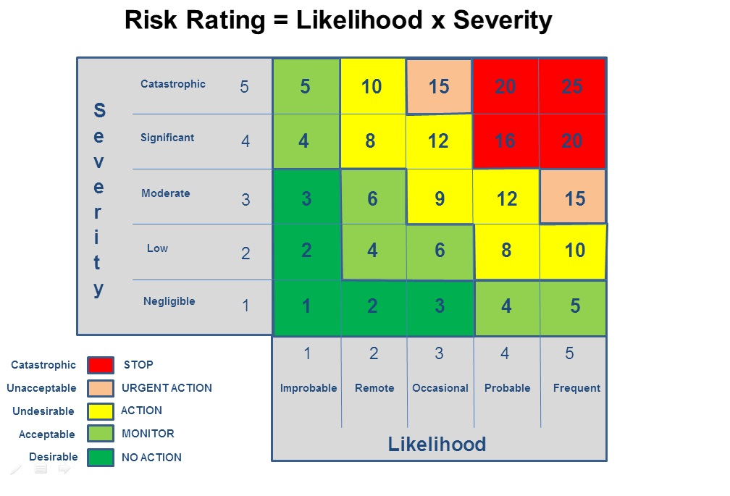
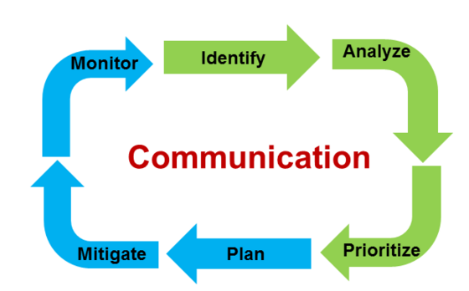
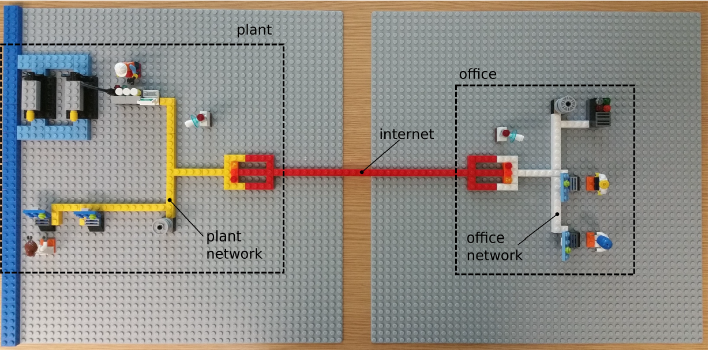

RISK PERCEPTION USING NLP
Gerard Tio Nogueras
UNIVERSITY OF
Southampton
School of Electronics and
Computer Science
Motivation
Risk Assessment tools
Decisions and Disruptions (D&D)
RISK MATRIX
We can compare risk-based decisions extracted with NLP and assess their accuracy. Improve prioritization of mitigations.
CONCEPT: Role playing game that simulates a cyber security environment.
OBJECTIVE: Analyse player’s behavior in regards to risk based decisions. Behavior is also compared in regards of their technical background in cyber security.
PROBLEM: Not enough games’ data to use results as scientific evidence and difficulty to scale the experience.
RISK CYCLE STEPS:
Understand the « Context » steps and match them with the risk cycle steps. This will help improve the methodology of the context.
Project
Context with Risk
Risk Perception
Risk based Context
Risk analysis on the extracted data
Analysis of the different risks:
Vulnerabilities
Assets
Impact
Capability
Comparison with the tools of Risk standard ISO27001:
Risk matrix
Risk management cycle
1
Text transcription
Speech with risk content
NLP Processing
2
Document with risk content
NLP Pipeline
Outcomes
Classifier research
Commercial and scientific
1. Pre-Process scripts
2. Pick an approach
3,Implement classifier
4. Test and analyse results
Commercial:
Scientific:

